Slide 1
Building Unconventional SQL Server Tools
aka: Building Unconventional SQL Server Tools in PowerShell with Advanced Functions and Script Modules
Demo Code: github.com/mikefrobbins/Presentations

Slide 2

Get-Help –Name ‘about_Presenter’
Mike F Robbins
Microsoft MVP on Windows PowerShell
SAPIEN Technologies MVP
Leader & Co-Founder of the Mississippi PowerShell User Group
Co-Author of Windows PowerShell TFM 4th Edition
Author of Chapter 6 in the PowerShell Deep Dives book
Winner of the Advanced Category in the 2013 Scripting Games
Learn more about me @ mikefrobbins.com

Slide 3
Write-Output ‘Questions for Audience’
IT Pro’s
Developers
DBA’s
Microsoft SQL Server
Transact-SQL (T-SQL)
.NET Framework
Source Control
Unit Testing via Pester
PS Script Analyzer

Slide 4
Set-Content ‘Information to Cover’
SQL PowerShell Module and Snap-in
SQL PowerShell Provider
SMO (SQL Management Objects)
.NET Framework
TSQL versus Cmdlets
Functions
Modules
Toolmaking
Automation
Using PowerShell to write dynamic TSQL code

Slide 5
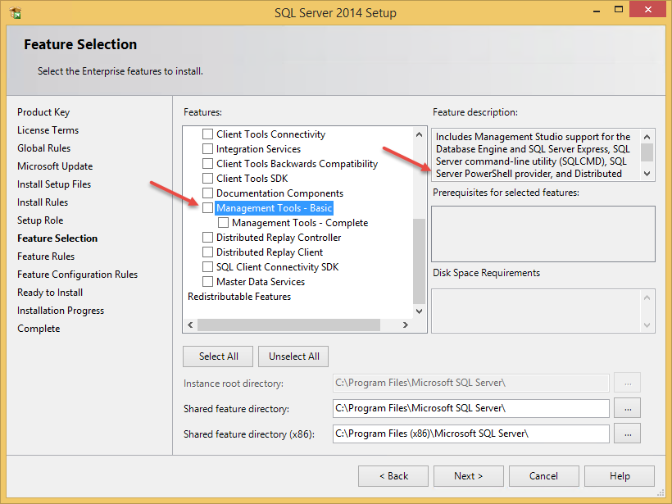
Install the SQL PowerShell Module (Old)

Slide 6
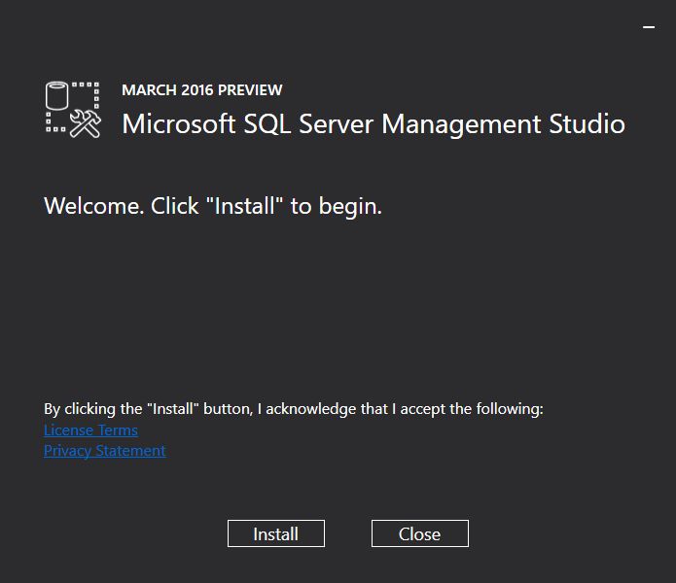
Install the SQL PowerShell Module (New)

Slide 7

Start-Process ‘Demo’

Slide 8
Celebrating 10 Years of PowerShell 2006 - 2016
Jeffrey Snover
Kenneth Hansen
Lee Holmes
Narayanan Lakshmanan
Hemant Mahawar
Bruce Payette
Hitesh Raigandhi
Dan Travison
Jim Truher
Krishna Vutukuri
Congratulations to the team members who’ve been there since the beginning…
...and thanks for all the great work!

Slide 9
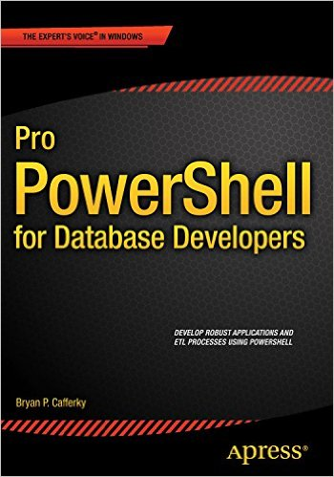
Select-Object –Property ‘Resources’
Free:
PowerShell.org
PowerShell Virtual Chapter of SQL PASS
SQL Saturday Technology Events
Microsoft Virtual Academy
SAPIEN Technologies
PowerShell Magazine
User Groups
Twitter
GitHub
Blogs
PowerShell Best Practices and Style Guide
Paid:
Pro PowerShell for Database Developers book
Pluralsight

Slide 10

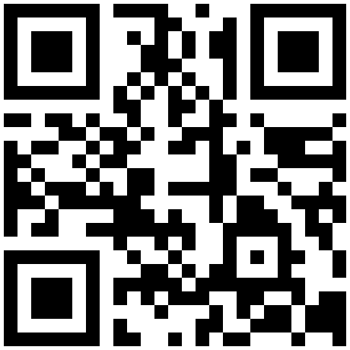

Get-Contact –Identity ‘Presenter’
Blog: mikefrobbins.com (or MrPowerShell.com)
Twitter: @mikefrobbins
LinkedIn: www.linkedin.com/in/mikefrobbins
Email: See mikefrobbins.com/about/
User Group: mspsug.com (or MsPowerShell.com)

